Slide 1
Network+ Guide to Networks Eighth Edition
Chapter 10
Security in Network Design
© 2019 Cengage. All Rights Reserved. May not be copied, scanned, or duplicated, in whole or in part, except for use as permitted in a license distributed with a certain product or service or otherwise on a password-protected website for classroom use.

Slide 2
Objectives (1 of 2)
10.1 Describe the functions and features of various network security devices
10.2 Implement security precautions on a switch
10.3 Track the processes of authentication, authorization, and auditing on a network

Slide 3
Objectives (2 of 2)
10.4 Explain the available options in network access control methods
10.5 Configure various security measures on a wireless network

Slide 4
Network Security Devices
Non-security devices with security features
Proxy servers and A C Ls
Specialized security devices
Firewalls and I D S/I P S systems
Using multiple options for network security results in layered security
Provides more protection than any one type of device

Slide 5
Proxy Servers (1 of 2)
Proxy server:
Acts as an intermediary between external and internal networks
Screens all incoming and outgoing traffic
Manages security at Application layer
Appears as an internal network server to the outside world, but is a filtering device for internal LAN
One of its most important functions is preventing the outside world from discovering the addresses of the internal network
Reverse proxy:
Provides services to Internet clients from servers on its own network
Provides identity protection for the server rather than the client
Useful when multiple Web servers are accessed through the same public I P address

Slide 6
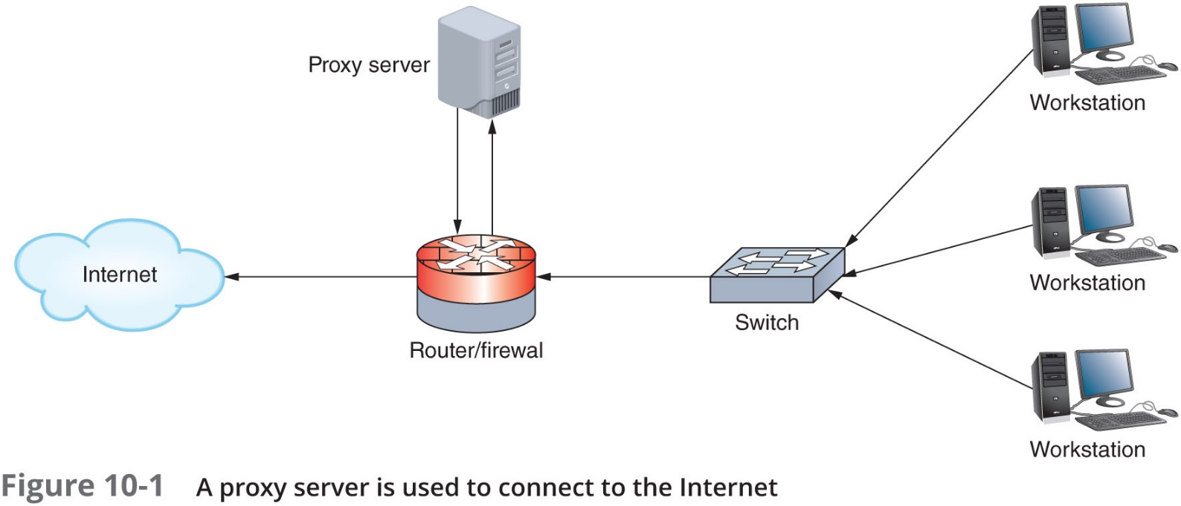
Proxy Servers (2 of 2)

Slide 7
A C Ls (Access Control Lists) on Network Devices (1 of 4)
Router’s main functions:
Examine packets
Determine destination based on Network layer addressing information
A C L (access control list):
Used by routers to decline forwarding certain packets
Acts like a filter to instruct the router to permit or deny traffic according to one or more of the following variables:
Network layer protocol (e.g., IP or I C M P)
Transport layer protocol (e.g., T C P or U D P)
Source IP address
Destination IP address
T C P or U D P port number

Slide 8
A C Ls (Access Control Lists) on Network Devices (2 of 4)
Router receives packet, examines packet:
Refers to A C L for permit, deny criteria
Drops packet if deny characteristics match
Forwards packet if permit characteristics match
If the packet does not match any criteria given, the packet is dropped
Called the implicit deny rule
On most routers, each interface must be assigned a separate A C L
Different A C Ls may be associated with inbound and outbound traffic

Slide 9
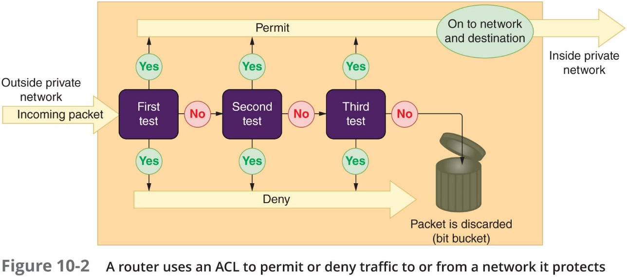
A C Ls (Access Control Lists) on Network Devices (3 of 4)

Slide 10
A C Ls (Access Control Lists) on Network Devices (4 of 4)
The access-list command is used to assign a statement to an already-installed A C L
Must identify the A C L and include a permit or deny argument
Example: To permit I C M P traffic from any IP address or network to any I P address or network:
access-list acl_2 permit i c m p any
Example: To permit T C P traffic from 2.2.2.2 host machine to 5.5.5.5 host machine:
access-list acl_2 permit t c p host 2.2.2.2 host 5.5.5.5
A C Ls do affect router performance
The more statements or tests a router must scan the more time it takes a router to act

Slide 11
Firewalls (1 of 9)
A firewall is a specialized device or software that selectively filters or blocks traffic between networks
Typically involves hardware and software combination
Firewall location:
Between two interconnected private networks
Between private and public networks (network-based firewall)
May also see firewall features integrated in routers, switches, and other network devices
Other types of firewalls only protect the computer on which they are installed
Known as host-based firewalls

Slide 12
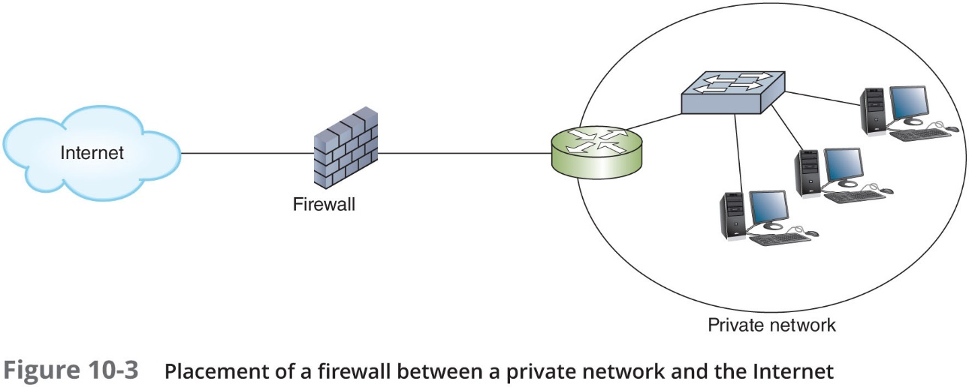
Firewalls (2 of 9)

Slide 13
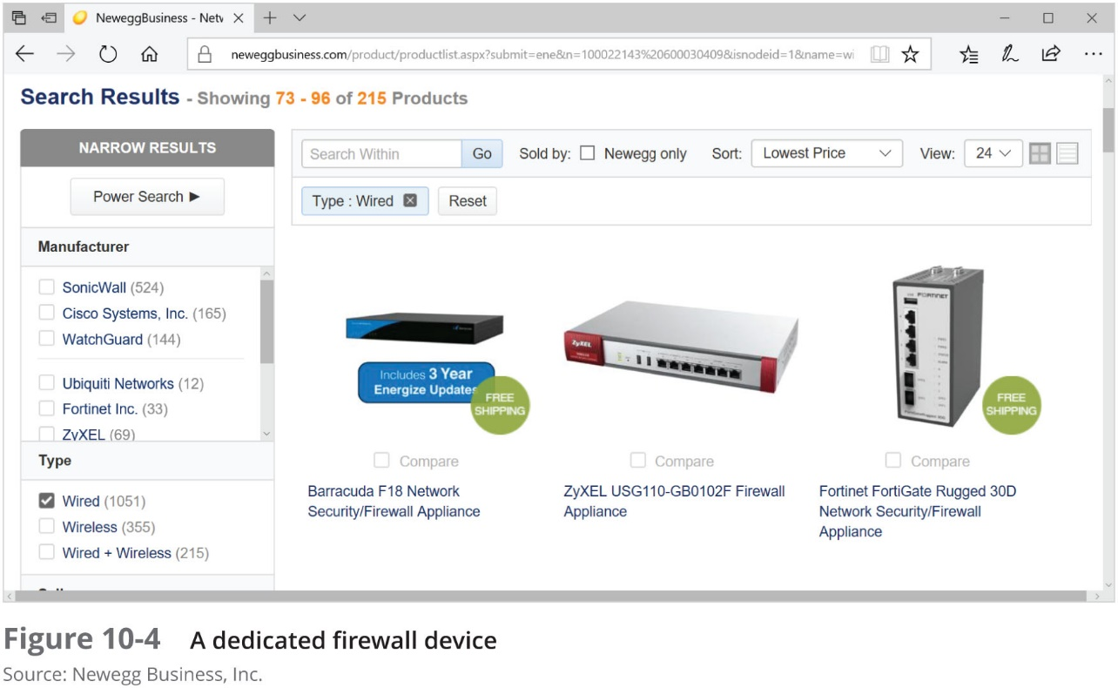
Firewalls (3 of 9)

Slide 14
Firewalls (4 of 9)
Packet-filtering firewall:
Simplest firewall
Examines header of every entering packet (inbound traffic)
Can block traffic entering or exiting a LAN (outbound traffic)
Firewall default configuration:
Blocks most common security threats
Preconfigured to accept and deny certain traffic types
Network administrators often customize settings

Slide 15
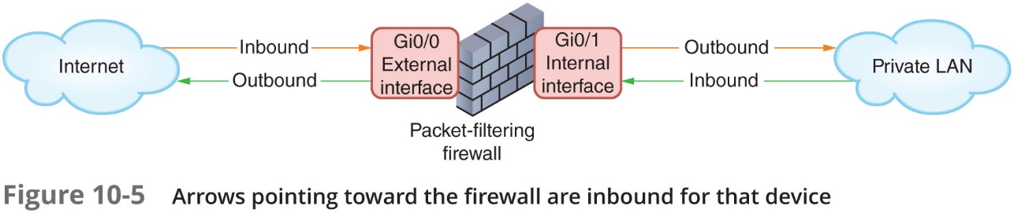
Firewalls (5 of 9)

Slide 16
Firewalls (6 of 9)
Common packet-filtering firewall criteria:
Source and destination IP addresses
Source and destination ports
Flags set in the T C P header
Transmissions using U D P or I C M P protocols
Packet’s status as the first packet in new data stream, subsequent packet
Packet’s status as inbound to, outbound from private network

Slide 17
Firewalls (7 of 9)
Port blocking
Prevents connection to and transmission completion through ports
Optional firewall functions:
Encryption
User authentication
Centralized management
Easy rule establishment
Content-filtering based on data contained in packets
Logging, auditing capabilities
Protect internal LAN’s address identity
Monitor packets according to existing traffic streams (stateful firewall)
A stateless firewall manages each incoming packet as a stand-along entity without regard to active connections

Slide 18
Firewalls (8 of 9)
Unified Threat Management (U T M):
Security strategy that combines multiple layers of security appliances and technologies into a single safety net
Requires a great deal of processing power
Next Generation Firewalls (N G F W):
Have built-in Application Control features and are application aware
They can monitor and limit traffic of specific applications
Adapt to the class of a specific user or user group
May also be context aware
They adapt to various applications, users, and devices

Slide 19
Firewalls (9 of 9)
Troubleshooting firewalls:
Most common cause of firewall failure is firewall misconfiguration
Configuration must not be so strict that it prevents authorized users from transmitting and receiving necessary data
But no so lenient that you unnecessarily risk security breaches
You may need to create exceptions to the rules
Referred to as “punching a hole” in the firewall

Slide 20
I D S (Intrusion Detection System) (1 of 2)
I D S (intrusion detection system):
Stand-along device, an application, or a built-in feature running on a workstation, server, switch, router, or firewall
Monitors network traffic and generates alerts about suspicious activity
Commonly exists as an embedded feature in U T M solutions or N G F Ws
Two primary methods for detecting threats:
Statistical anomaly detection
Compares network traffic samples to a predetermined baseline in order to detect anomalies
Signature-based detection
Looks for identifiable patterns (signatures) of code that are known to indicate specific vulnerabilities, exploits, or other undesirable traffic

Slide 21
I D S (Intrusion Detection System) (2 of 2)
I D S implementations:
H I D S (host-based I D S) runs on a single computer to alert about attacks to that one host
Might also include F I M (file integrity monitoring) which alerts when any changes made to files that shouldn’t change
N I D S (network-based I D S) protects a network and is usually situated at the edge of the network or in the D M Z (demilitarized zone)
Network’s protective perimeter
Port mirroring
One port makes copy of traffic and sends to second port for monitoring
I D S drawback
Number of false positives logged

Slide 22
I P S (Intrusion Prevention System) (1 of 2)
I D S can only detect and log suspicious activity
I P S (intrusion prevention system):
Reacts to suspicious activity when alerted
Detects threat and prevents traffic from flowing to network
Based on originating IP address
N I P S (network-based intrusion prevention)
Protects entire networks
H I P S (host-based intrusion prevention)
Protects certain hosts

Slide 23
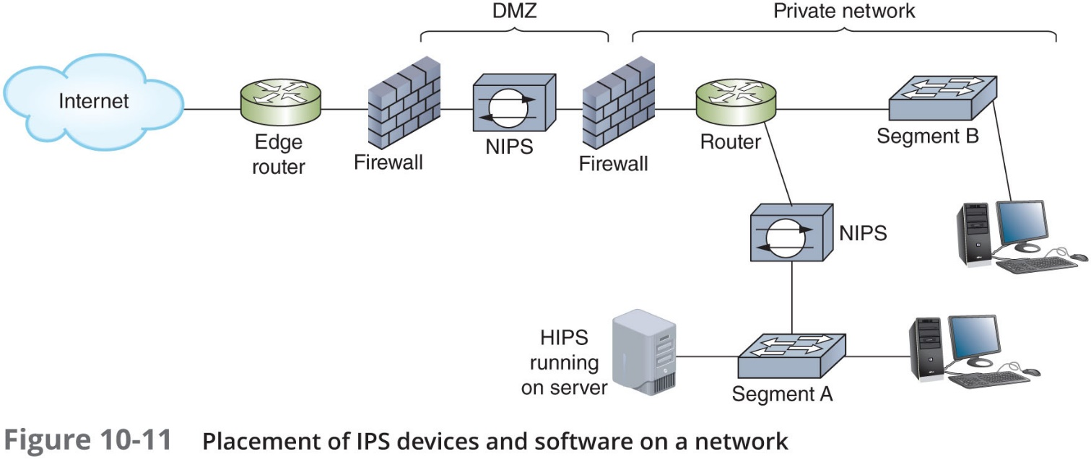
I P S (Intrusion Prevention System) (2 of 2)

Slide 24
S I E M (Security Information and Event Management)
S I E M systems can be configured to evaluate all log data
Looking for significant events that require attention from the IT staff
Effectiveness of the S I E M
Determined by the amount of storage space needed for the amount of data generated
Network administrators can fine-tune a S I E M’s configuration rules for the specific needs
Which event should trigger responses
Network technicians should review raw data on a regular basis
To ensure no glaring indicators are being missed by existing rules

Slide 25
Switch Management
This section covers the following:
How paths between switches are managed
Switch security concerns (Physical, Data Link, and Network layers)

Slide 26
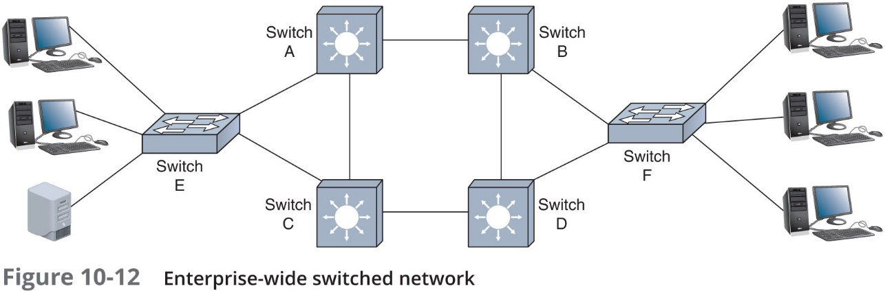
Switch Path Management (1 of 5)
To make networks more fault tolerant
You install multiple (redundant) switches at critical junctures
Redundancy allows data the option of traveling through more than one switch
Makes a network less vulnerable to hardware malfunctions
A potential problem with redundant paths is traffic loops

Slide 27
Switch Path Management (2 of 5)
S T P (Spanning Tree Protocol):
Defined in I E E E standard 802.1D
Operates in Data Link layer
S T P prevents traffic loops:
Calculating paths avoiding potential loops
Artificially blocking links completing loop
If a switch is removed, S T P will recalculate the best loop-free data paths between the remaining switches

Slide 28
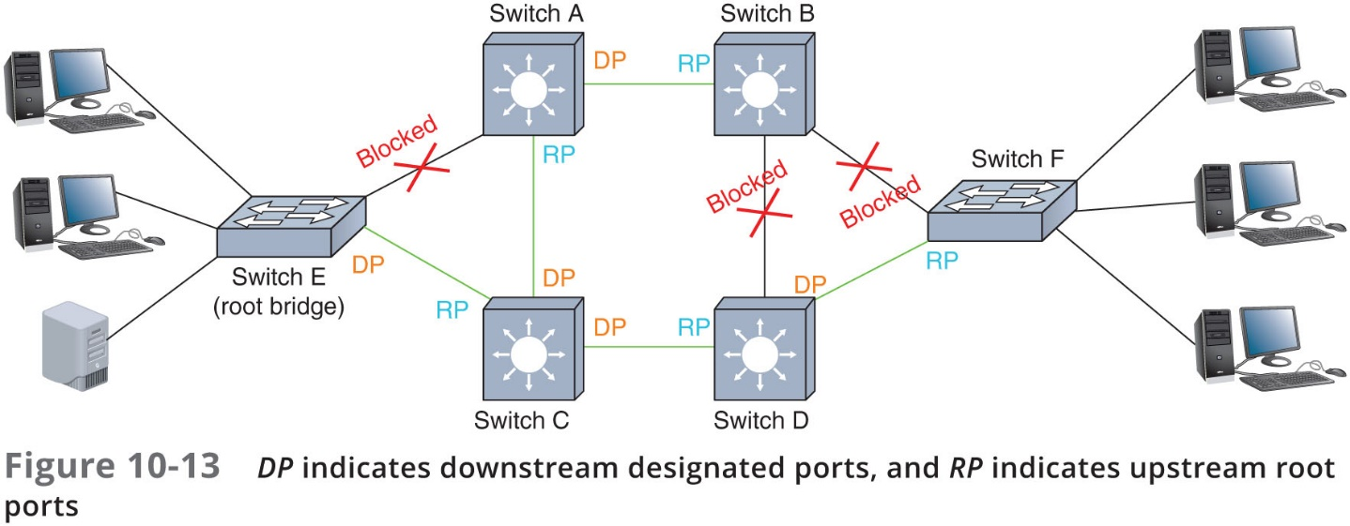
Switch Path Management (3 of 5)
Three steps:
Select root bridge based on Bridge I D (B I D)
Examine possible paths between network bridge and root bridge
Disables links not part of shortest path

Slide 29
Switch Path Management (4 of 5)
S T P information is transmitted between switches
Via B P D Us (Bridge Protocol Data Units)
Security precautions that must be configured on S T P-enabled interfaces:
B P D U guard—Blocks B P D Us on any port serving network hosts
Ensures these devices aren’t considered as possible paths
B P D U filter—Can be used to disable S T P on specific ports
Root guard—Prevents switches beyond the configured port from becoming the root bridge

Slide 30
Switch Path Management (5 of 5)
Newer (faster) versions of S T P include:
R S T P (Rapid Spanning Tree Protocol) and M S T P (Multiple Spanning Tree Protocol)
T R I L L (Transparent Interconnection of Lots of Links)
A multipath, link-state protocol
S P B (Shortest Path Bridging)
A descendent of S T P that operates at Layer 3
Keeps all potential paths active while managing flow of data
Some switch manufacturers have designed proprietary versions of S T P
Example: Cisco and Extreme Networks

Slide 31
Switch Port Security
Unused physical and virtual ports on switches and other network devices should be disabled:
Use the shutdown command on Cisco, Huawei, and Arista routers and switches
Use the no shutdown command to enable them again
Another Cisco command (also used on Arista devices) to secure switch access ports:
Switchport port-security (or just port-security on Huawei switches)
Essentially a MAC filtering functions that also protects against MAC flooding
On a Juniper switch:
The mac-limit command restricts the number of MAC addresses allowed in the MAC address table
Allowed MAC addresses are configured with the allowed-mac command

Slide 32
A A A (Authentication, Authorization, and Accounting)
Controlling users’ access to a network and its resources consists of three major elements:
Authentication—Process of verifying user’s credentials to grant user access to secured resources
Authorization—Determines what the user can and cannot do with network resources
Accounting—To keep an account of the client’s system or network usage

Slide 33
Authentication (1 of 3)
A user can be authenticated to the local device or to the network
Local authentication—Usernames and passwords are stored locally which has both advantages and disadvantages:
Low security
Convenience varies
Reliable backup access
With local authentication
Every computer on the network is responsible for securing its own resources
In Windows
Switch from local authentication to network authentication on the domain using the System Properties dialog box

Slide 34
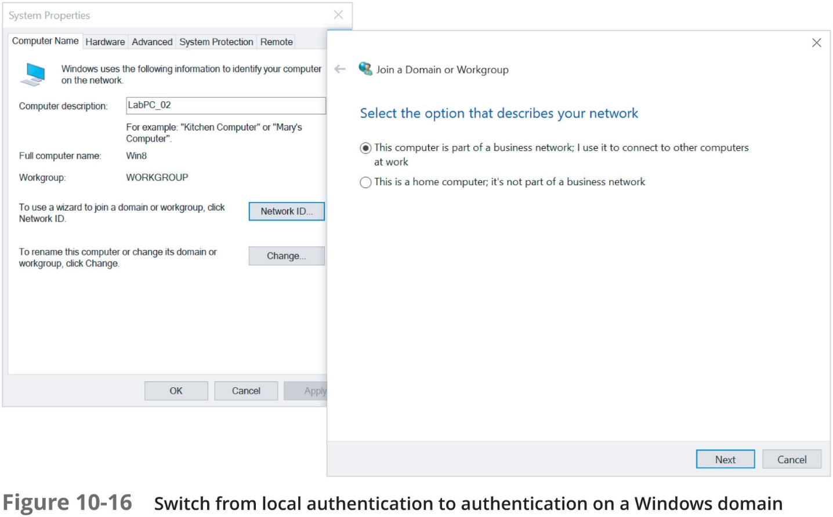
Authentication (2 of 3)

Slide 35
Authentication (3 of 3)
Network authentication and logon restrictions:
Harden your network by requiring secure passwords to authenticate to the network
Additional authentication restrictions that strengthen network security:
Time of day
Total time logged on
Source address
Unsuccessful logon attempts
Geographic location (geofencing)

Slide 36
Authorization (1 of 2)
User access to network resources falls into one of the two categories:
The privilege or right to execute, install, and uninstall software
Permission to read, modify, create, or delete files and folders
R B A C (role-based access control):
Most popular authorization method
Administrator assigns privileges and permissions necessary for users to perform their roles (duties)
Administrators create groups associated with certain roles
Role separation
Each user can only be a member of a single group

Slide 37
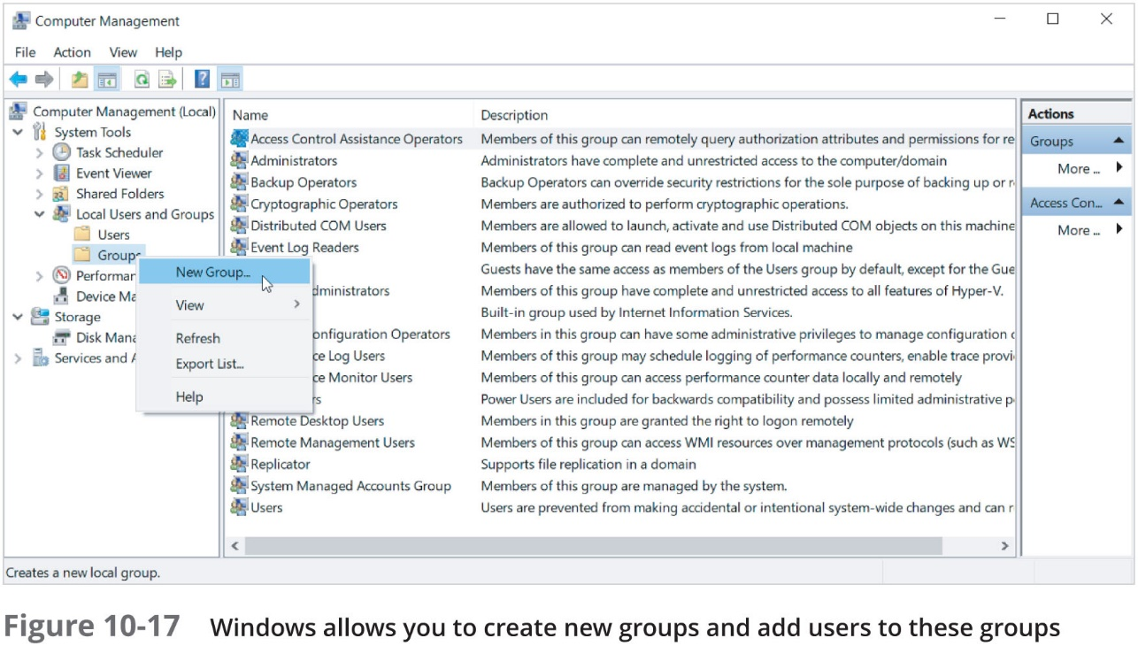
Authorization (2 of 2)

Slide 38
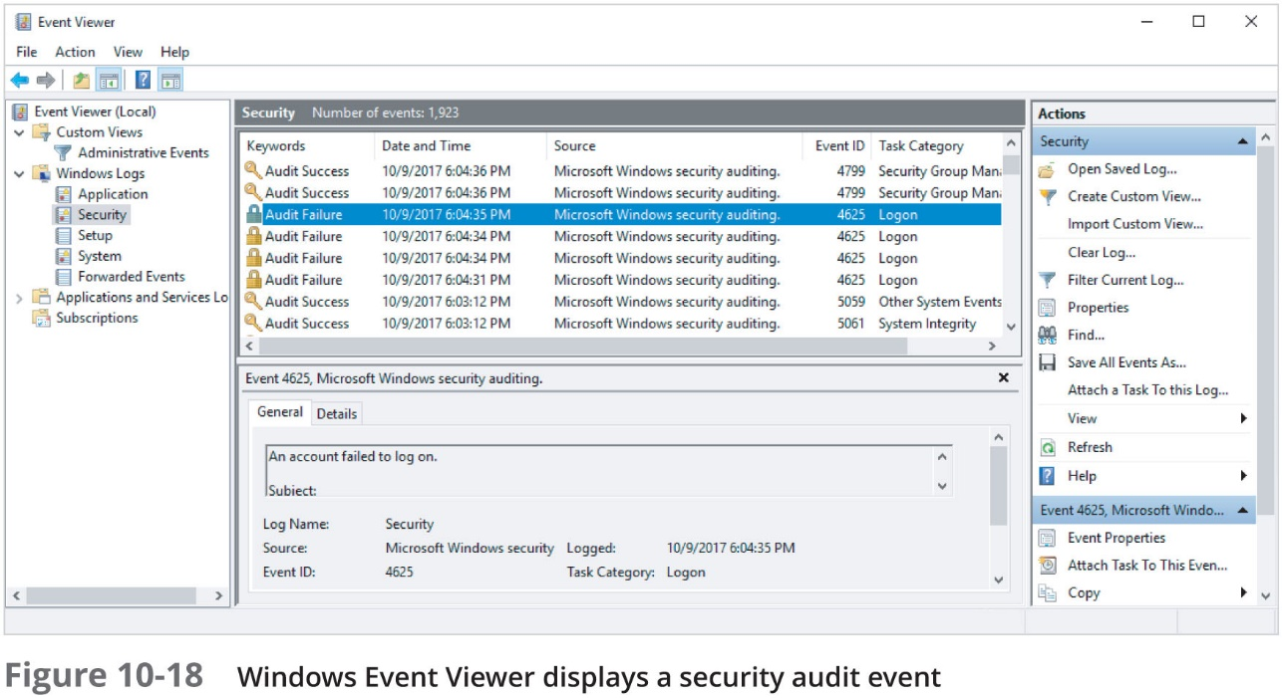
Accounting
A log file viewer can be installed to make it easier to monitor log files for interesting or suspicious events
In Windows, use Event viewer to view Windows logs

Slide 39
N A C (Network Access Control) (1 of 2)
A network access control (N A C) solution employs a set of rules called network policies which determine the level and type of access granted to a device when it joins a network
N A C authenticates and authorizes devices
By verifying that the device complies with predefined security benchmarks
An agent can be installed on the device before it can be authenticated
Monitors device’s status to determine the device’s compliance

Slide 40
N A C (Network Access Control) (2 of 2)
Two types of agents:
Nonpersistent agent remains on the device long enough to verify compliance and complete authentication and then uninstalls
Also called dissolvable agent
Persistent agent is permanently installed on a device
Devices that do not meet compliance requirements can be placed in a quarantine network
Separate from sensitive network resources

Slide 41
Access Control Technologies
Authentication protocols
The rules computers follow to accomplish authentication
Several types of authentication services and protocols exist

Slide 42
Directory Services
Directory service
Maintains a database of account information, such as, usernames, passwords, and other authentication credentials
Examples:
A D (Active Directory) in Windows
Open L D A P
389 Directory Server
L D A P (Lightweight Directory Access Protocol):
Standard protocol for accessing an existing directory
All the above are built to be L D A P-compliant
AD is configured to use the Kerberos protocol

Slide 43
Kerberos (1 of 6)
Kerberos
Cross-platform authentication protocol
Uses key encryption:
Verifies client identity
Securely exchanges information after client logs on
Example of a private key encryption service
Provides significant security advantages over simple N O S authentication

Slide 44
Kerberos (2 of 6)
Terms:
Principal
K D C (Key Distribution Center)
Ticket
Kerberos server runs two services:
A S (authentication service)
Initially validates a client
T G S (ticket-granting service)
An application running separate from the AS that also runs on the K D C
Alleviates the need for the client to request a new ticket from the T G S each time it wants to use a different service on the network

Slide 45
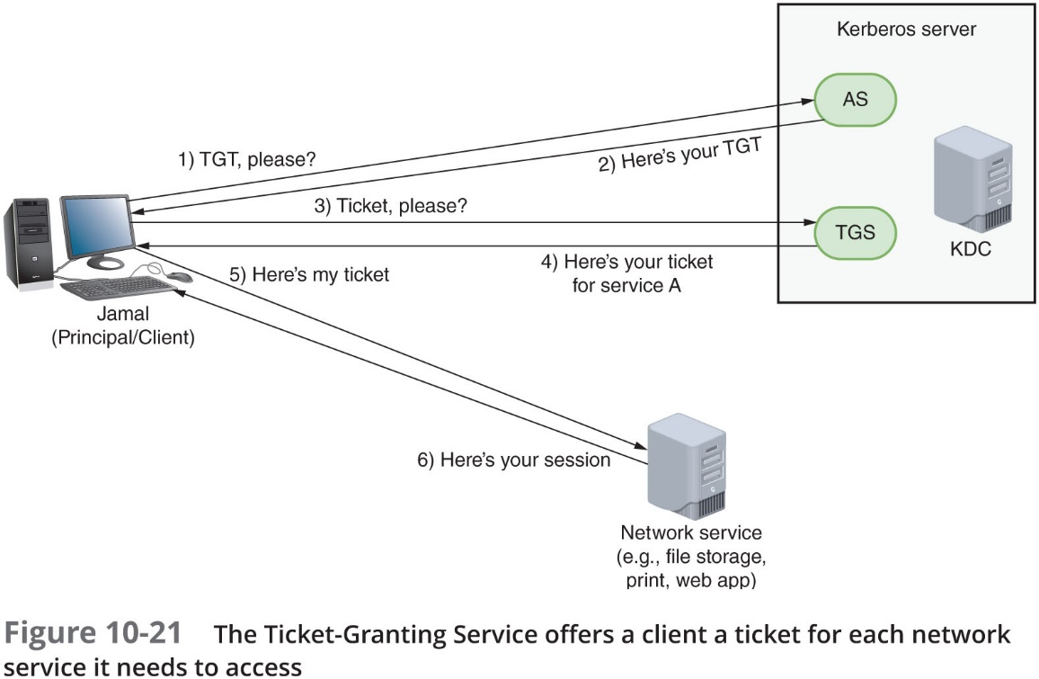
Kerberos (3 of 6)

Slide 46
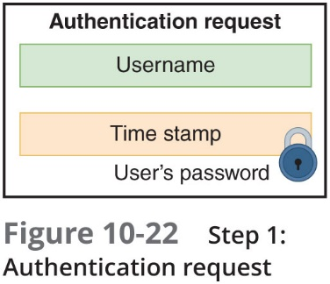
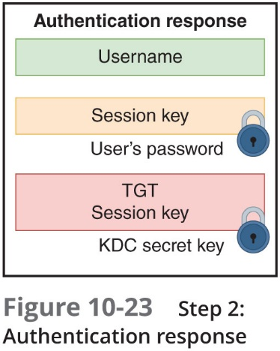
Kerberos (4 of 6)

Slide 47
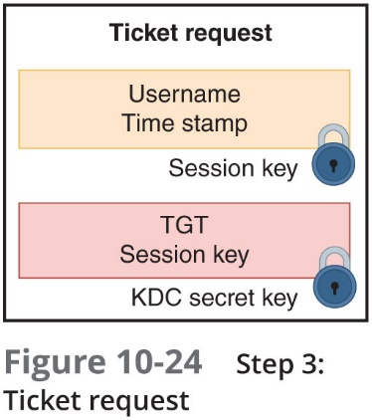
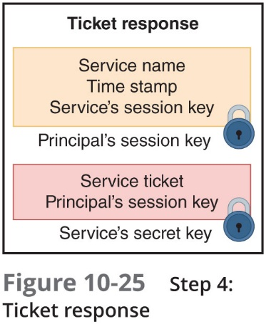
Kerberos (5 of 6)

Slide 48
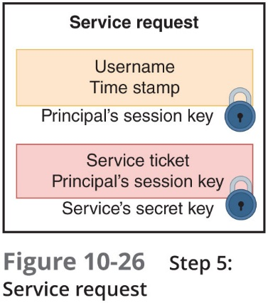
Kerberos (6 of 6)

Slide 49
S S O (Single Sign-On) (1 of 2)
S S O:
Form of authentication in which a client signs on one time to access multiple systems or resources
Primary advantage is convenience
Disadvantage is that once authentication is cleared, the user has access to numerous resources
2F A (two-factor authentication)
User must provide something and know something
M F A (multifactor authentication)
Process that requires two or more pieces of information

Slide 50
S S O (Single Sign-On) (2 of 2)
Five categories of authentication factors:
Something you know—password or PIN
Something you have—A T M or smart card
Something you are—fingerprint or facial pattern
Somewhere you are—location in a specific building
Something you do—specific way you type or speak
M F A requires at least one authentication method from at least two different categories
Security token
A device or application that stores or generates information

Slide 51
RADIUS (Remote Authentication Dial-In User Service) (1 of 2)
RADIUS (Remote Authentication Dial-In User Service):
Open-source and standardized by the I E T F
Runs in the Application layer and can use either U D P or T C P in the Transport layer
Can operate as application on remote access server
Or on dedicated RADIUS server
Highly scalable
May be used to authenticate wireless, mobile, and remote users
RADIUS services are often combined with other network services on a single machine

Slide 52
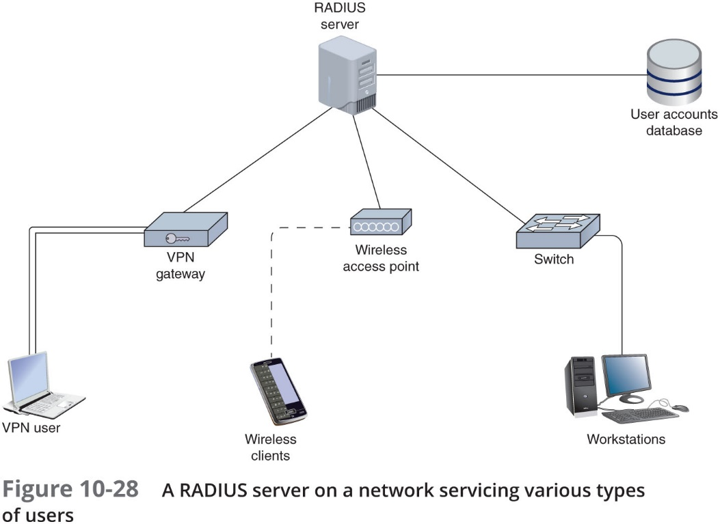
RADIUS (Remote Authentication Dial-In User Service) (2 of 2)

Slide 53
T A C A C S+ (Terminal Access Controller Access Control System Plus)
T A C A C S+ (Terminal Access Controller Access Control System Plus):
Offers the option of separating authentication, authorization, and auditing capabilities
Differences from RADIUS:
Relies on T C P, not U D P, at the Transport layer
Proprietary protocol developed by Cisco Systems, Inc.
Typically installed on a router or switch, rather than a server
Encrypts all information transmitted for AAA

Slide 54
Wireless Network Security
Recall a disadvantage of W E P
Used a shared key for all clients and the key might never change
W E P offered two forms of authentication:
O S A (Open System Authentication)
S K A (Shared Key Authentication)

Slide 55
W P A (Wi-Fi Protected Access)
T K I P (Temporal Key Integrity Protocol)
Encryption key generation and management scheme
T K I P accomplishments:
Message integrity
Key distribution
Encryption
T K I P was a quick fix and is only offered today in order to provide compatibility with older wireless devices

Slide 56
W P A2 (Wi-Fi Protected Access, version 2)
Data confidentiality methods used in W P A were replaced by stronger technologies
C C M P—Short for Counter Mode with C B C (Cipher Block Chaining) MAC (Message Authentication Code) Protocol
Improves wireless security for newer devices that can use W P A2
C C M P helps ensure data confidentiality with both encryption and packet authentication by providing:
Message integrity
Encryption—Uses A E S (Advanced Encryption Standard), which provides faster and more secure encryption than T K I P

Slide 57
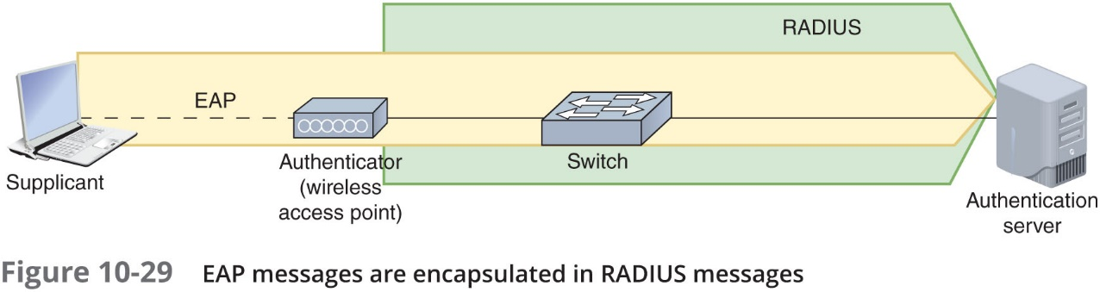
Personal and Enterprise (1 of 6)
Personal versions of W P A and W P A2:
Sometimes referred to as W P A-P S K or W P A2-P S K
P S K is short for Pre-Shared Key
Enterprise versions of W P A and W P A2:
Implement additional security measures
A RADIUS server is used in cooperation with an authentication mechanism called E A P (Extensible Authentication Protocol)

Slide 58
Personal and Enterprise (2 of 6)
Three main E A P entities (shown in Figure 10-29 on previous slide):
Supplicant—Device requesting authentication
Authenticator—Device that initiates the authentication process (wireless access point)
Authentication server—Server that performs authentication

Slide 59
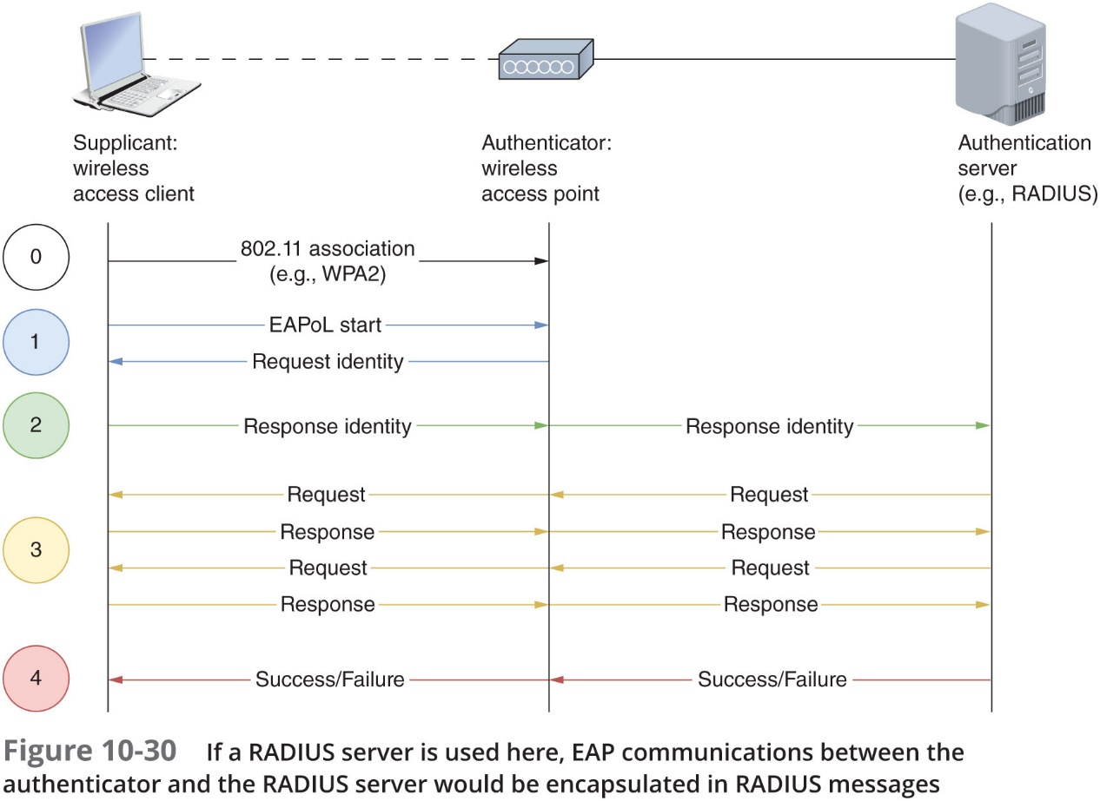
Personal and Enterprise (3 of 6)

Slide 60
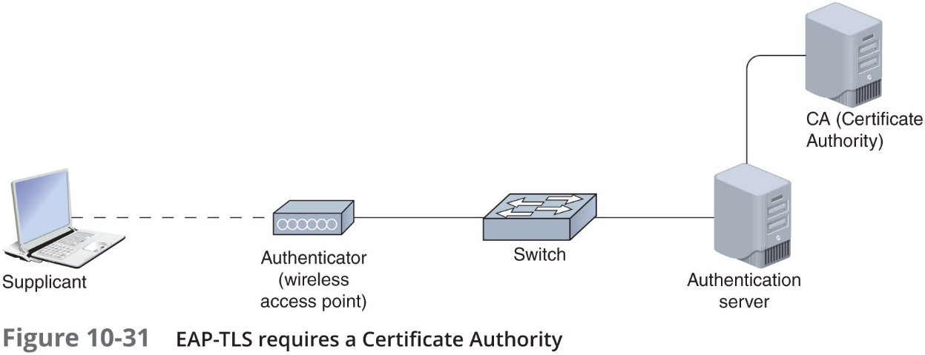
Personal and Enterprise (4 of 6)
E A P-T L S
Uses T L S encryption to protect communications
Uses P K I certificates to exchange public keys and authenticate both supplicant and the server (called mutual authentication)

Slide 61
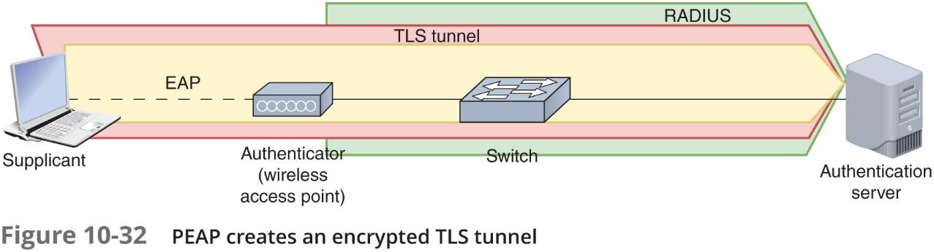
Personal and Enterprise (5 of 6)
P E A P (Protected E A P)
Tunnel-based
Creates an encrypted T L S tunnel between the supplicant and the server

Slide 62
Personal and Enterprise (6 of 6)
E A P-F A S T (E A P-Flexible Authentication via Secure Tunneling)
A form of tunneled E A P
Developed by Cisco and works similarly to PEAP (only faster)
Uses P A Cs (Protected Access Credentials) stored on the supplicant device for speedier establishment of the T L S tunnel

Slide 63
Chapter Summary (1 of 4)
A proxy server acts as an intermediary between the external and internal networks
Thanks to a router’s A C L or access list, routers can decline to forward certain packets depending on their content
A firewall is a specialized device or software that selectively filters or blocks traffic between networks
An I D S (intrusion detection system) is a stand-alone device, an application, or a built-in feature running on a workstation, server, switch, router, or firewall, which is used to monitor network traffic
I D S, I P S, firewalls, and proxy servers all generate a great deal of data that is stored in logs and must be monitored and analyzed

Slide 64
Chapter Summary (2 of 4)
S T P (Spanning Tree Protocol) prevents traffic loops by calculating paths that avoid potential loops and blocking links that would complete a loop
Unused physical and virtual ports on switches and other network devices should be disabled until needed
Controlling users’ access to a network consists of three major elements: authentication, authorization, and accounting
With geofencing, G P S or R F I D data is sent to the authentication server to report the location of the device attempting to authenticate to the network
Systems generate many logs that can be used for troubleshooting and auditing
A N A C system employs a set of rules, called network policies, which determine the level and type of access granted to a device when it joins a network

Slide 65
Chapter Summary (3 of 4)
Kerberos is a cross-platform authentication protocol that uses key encryption to verify identity of clients and to securely exchange information after a client logs on to a system
Kerberos is an example of S S O (single sign-on)
The most popular A A A service is RADIUS (Remote Authentication Dial-In User Service)
T A C A C S+ (Terminal Access Controller Access Control System Plus) offers network administrators the option of separating the access, authentication, and auditing capabilities
W E P offered two forms of authentication, neither of which is secure: O S A (Open System Authentication) and S K A (Shared Key Authentication)

Slide 66
Chapter Summary (4 of 4)
T K I P was a quick fix, designed more as an integrity check for W E P transmissions than as a sophisticated encryption protocol
C C M P improves wireless security for newer devices that can use W P A2
The Personal versions of W P A and W P A2 are sometimes referred to as W P A-P S K
The Enterprise versions of W P A and W P A2 implement additional security measures

